Slide 1
Version Control
PDE4430

Slide 2
Introduction
Very important to have version control
Super useful for software development – And other documents too
Used for:
Tracking code changes
Tracking who made changes
Coding collaboration

Slide 3
What Does Git Do?
Manage projects with Repositories
Clone a project to work on a local copy
Control and track changes with Staging and Committing
Branch and Merge to allow for work on different parts and versions of a project
Pull the latest version of the project to a local copy
Push local updates to the main project

Slide 4
How Does Git Work?
Initialize Git on a folder, making it a Repository
Git now creates a hidden folder to keep track of changes in that folder
When a file is changed, added or deleted, it is considered modified
You select the modified files you want to Stage
The Staged files are Committed, which prompts Git to store a permanent snapshot of the files
Git allows you to see the full history of every commit
You can go back to any previous commit

Slide 5
What is GitHub/GitLab/BitBucket?
Git is not the same as GitHub
GitHub makes tools that use Git
GitHub is the largest host of source code in the world – Has been owned by Microsoft since 2018

Slide 6
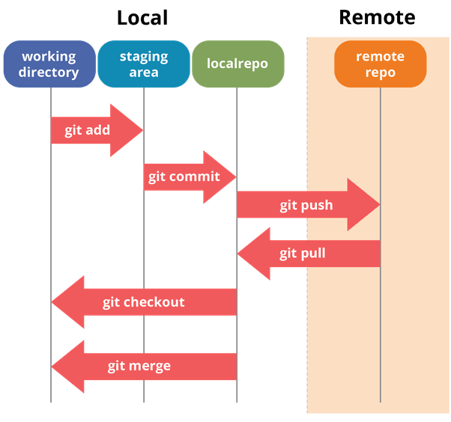
Git Structure
If you consider a file in your Working Directory, it can be in three possible states:
It can be staged – Files with the updated changes are marked to be committed to the local repository but not yet committed
It can be modified – Files with the updated changes are not yet stored in the local repository
It can be committed – Changes you made to your file are safely stored in the local repository

Slide 7
Git
One of the best tools for version control
Lots of help available online
Basic commands:
git init – Initialises a local repository
git add . – Stages all changed files
git status – Shows you the status of the repository
git commit -m “message” – Commits staged files
git branch branchName – Creates a new branch
git checkout branchName – Checks out the branch
git checkout –b branchName – Creates and checks out the branch
git merge branch2 – Merges current branch with branch2
git clone – Clones a remote repository on your local machine
git fetch – Fetches any changes that may have happened to the remote repo
git pull – Fetches and merges the remote changes
git push – Pushes your local changes to the remote repo
gitk --all – See the overall roadmap of the repository

Slide 8
Further Reading
A (very) simple guide for Git:
https://rogerdudler.github.io/git-guide/ ~ 10 minutes read
W3School tutorials on Git:
https://www.w3schools.com/git/ ~ Includes a quiz at the end as well
Microsoft Learning tutorial on Git:
https://docs.microsoft.com/en-us/learn/paths/intro-to-vc-git/

Slide 9
Example

Slide 10
Using Git
Steps (First time only):
Make a BitBucket (or GitLab) account
Make sure you have Git installed (you do)
$ git --version
Tell Git who you are:
$ git config --global user.name ”Sameer Kishore"
$ git config --global user.email ”s.kishore@mdx.ac.ae"

Slide 11
Using Git
Steps (For each project):
Initialise Git (git init)
Create files (scripts, launch files, message files, etc.)
Add files to staging area (git add)
Check status of files (git status)
Commit changes (git commit)
Add remote repository (git remote add origin)
Push changes (git push)
Create branches, push branches, fetch, pull, merge, pull requests, etc.

